Slide 1
Software Engineering Week 3 Investigating System Requirements

Slide 2
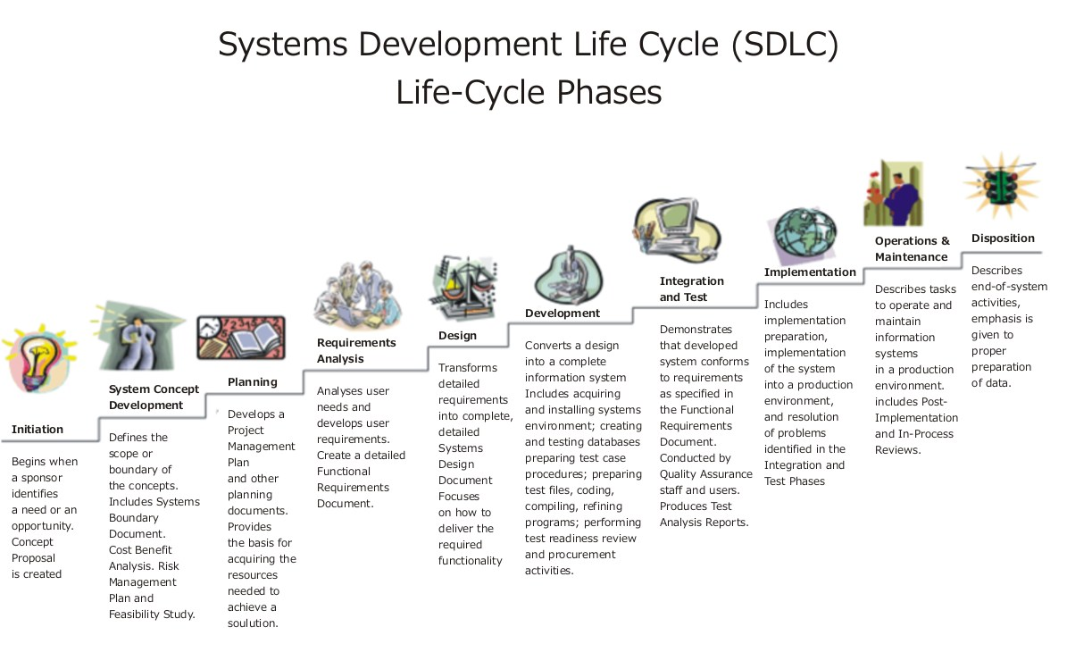
Where are we?

Slide 3
Systems Analysis Activities
Gather Detailed Information
Interviews, questionnaires, documents, observing business processes, researching vendors, comments and suggestions
Define Requirements
Modeling functional requirements and non-functional requirements
Prioritize Requirements
Essential, important, vs. nice to have
Develop User-Interface Dialogs
Flow of interaction between user and system
Evaluate Requirements with Users
User involvement, feedback, adapt to changes

Slide 4
What Are Requirements?
A requirement is a statement of what the system must do or a characteristic it must have.

Slide 5
Functional Requirements
A functional requirement is a process or activity the system must perform.
The system should create new order records
The system should update the purchase record
The system should print the invoice
The system should archive old accounts
Notes:
a functional requirement defines a function of a system or its component. A function is described as a set of inputs, the behavior, and outputs.
A typical functional requirement will contain a unique name and number, a brief summary, and a rationale. This information is used to help the reader understand why the requirement is needed, and to track the requirement through the development of the system.
Descriptions of data to be entered into the system.
Descriptions of operations performed by each screen.
Descriptions of work-flows performed by the system.
Descriptions of system reports or other outputs.
Who can enter the data into the system.
Interface requirements
Field 1 accepts numeric data entry.
Field 2 only accepts dates before the current date.
Screen 1 can print on-screen data to the printer.
Business Requirements
Data must be entered before a request can be approved.
Clicking the Approve button moves the request to the Approval Workflow.
All personnel using the system will be trained according to internal SOP AA-101.
Regulatory/Compliance Requirements
The database will have a functional audit trail.
The system will limit access to authorized users.
The spreadsheet can secure data with electronic signatures.

Slide 6
Non functional requirements
A non-functional requirement is a behavior that the system must have
Operational
The system should work on any web browser
Performance
The system should receive updated inventory information every 15 minutes
Security
Only direct managers can see personnel records
Notes:
a non-functional requirement (NFR) is a requirement that specifies criteria that can be used to judge the operation of a system, rather than specific behaviors.
Broadly, functional requirements define what a system is supposed to do and non-functional requirements define how a system is supposed to be
#1) Usability Testing Test cases.
#2) Performance Testing Test cases.
#3) Security Testing test cases.
Security: Does your product store or transmit sensitive information? Does your IT department require adherence to specific standards? What security best practices are used in your industry?
Capacity — What are your system’s storage requirements, today and in the future? How will your system scale up for increasing volume demands?
Compatibility — What are the minimum hardware requirements? What operating systems and their versions must be supported?
Reliability and Availability — What is the critical failure time under normal usage? Does a user need access to this all hours of every day?
Maintainability + Manageability—How much time does it take to fix components, and how easily can an administrator manage the system? Under this umbrella, you could also define Recoverability and Serviceability.
Scalability – The Black Friday test. What are the highest workloads under which the system will still perform as expected?
Usability — How easy is it to use the product? What defines the experience of using the product?

Slide 7
Interviews Questions
Decide what to ask and how to phrase the question
The same question to different people - for comparison
Open ended questions encourage spontaneous and unstructured responses
Close ended questions limit the response
Range of response questions limit the response

Slide 8
Open Questions
Open ended questions encourage spontaneous and unstructured responses
What are users saying about the new system?
How is this task performed?

Slide 9
Closed Questions
Close ended questions limit the response - used to verify facts
How many personal computers do you have in this department?
Do you review the reports before they are sent out?

Slide 10
Range Questions
Range of response questions limit the response – uses a scale
On a scale of 1 to 10, with 1 the lowest and 10 the highest, how effective was your training?
How would you rate the severity of the problem: low, medium, or high?

Slide 11
Types of questions for a questionnaire
Multiple-choice questions
Yes or No
Select one answer
Select as many as you like
Rating questions
From strongly agree to strongly disagree
Ranking questions
Numbering selected statements

Slide 12
Developing a questionnaire
Decide what facts you need to know
Decide who you need to ask
Write the questions and the responses
Proofread questions and responses
Test the questions on another team member
Edit if necessary

